Slide 1
Should We Go Retro?
Isaiah Crothers

Slide 2
Problem Statement
The CEO of a new vintage, remodel company that is going by the name of RetroTech, has reached out to go over and recall some vehicle specifications from a few decades back. The aim of the motor company at the moment is to roll-out an initial new wave of vehicles that are reminiscent of older style vehicles. RetroTech has pulled data from 1970 to 1982, narrowing down the car selection to a limited amount voted upon by customers. The company would like to very much push forward the best and most efficient few vehicles for their new line, to guarantee product success.

Slide 3
Benefits of the Data
Some of the benefits for the company are as follows:
Compare Miles per Gallon by vehicle
Comparisons that should weight compared to MPG and acceleration
Compare MPG by Area of Origin
These results will allow for the new company to begin their first wave of vehicles.

Slide 4
The Data

Slide 5
Methodology
The data that was collected and provided was split into two different data tables when first accessed.
Of the two tables, the ‘vehicle_specs’ table had to be purged of a few null columns within the set, to clean the data.
A right join was used on the two tables, ‘vehicle_specs’ and ‘vehicle_dictionary’, merging the two together for a more comprehensive view of the information.
The data was then able to show off year, name, cylinder count, MPG, acceleration, and a few other values within the same table.

Slide 6
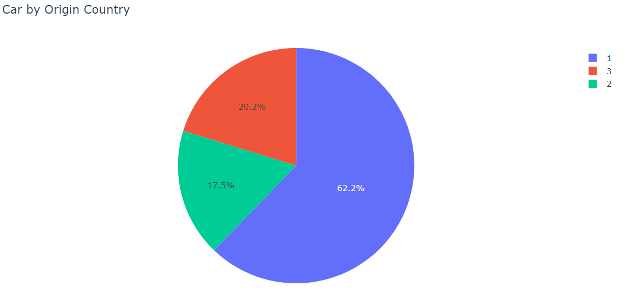
Data Findings
The first graph shows the total of all the cars within the dataset by their areas of Origin.
American made cars led the pack with 62% majority during this decade.
The European Market was the smallest slice of this pie, with 17.5%
The Asian market of manufacturing cars was the second largest market, compromising 20.2% of the overall cars with the specs sheets.

Slide 7
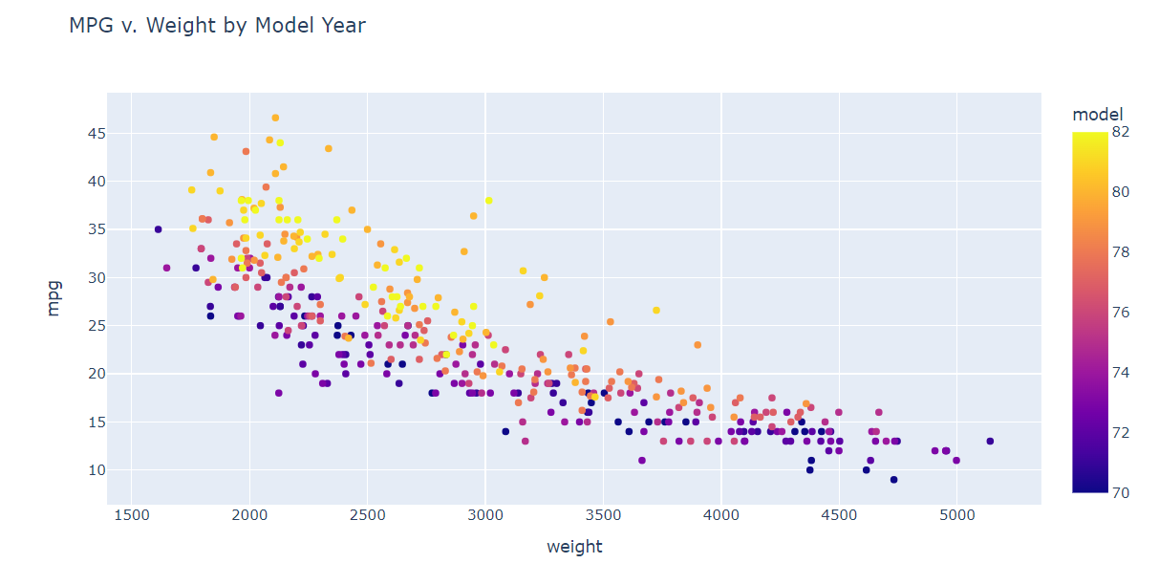
MPG v. Weight by Vehicle

Slide 8
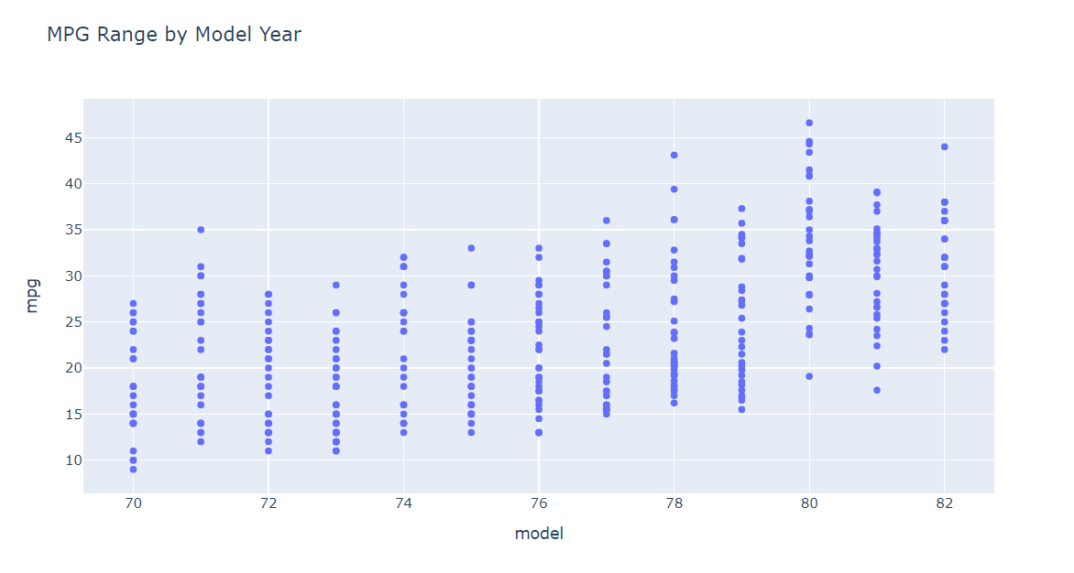
Miles Per Gallon
The general range of the MPG per model year a pretty gradual build in performance.
The best three model years per average were the years of 1980, 1981, 1982
The three years with the top highest MPG performance, were 1978, 1980, and 1982

Slide 9
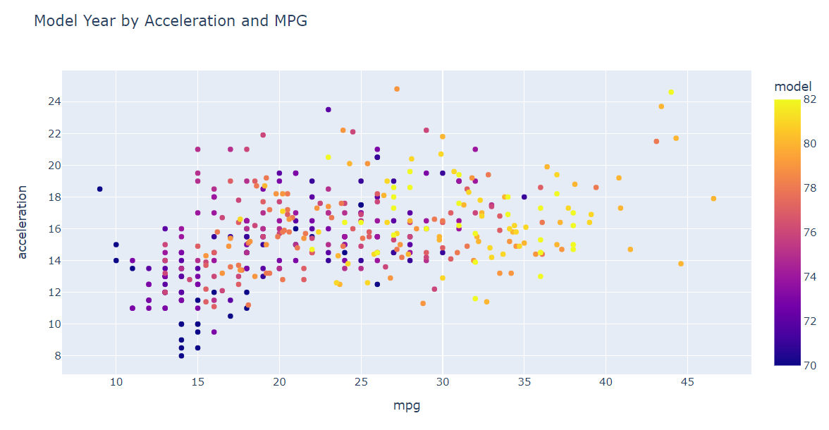
Data Continued
This graph is a representation of each car within the dataset, depicted by year, acceleration, and miles per gallon.
The general range of cars within the range of 1980-82, boast an impressive average MPG, alongside a higher average acceleration as well.
The lowest performing years came from around the early 70’s, with extremely low MPGs, with mild acceleration rates to accompany.
Within the top five highest MPG, four of the vehicles fall into the 1978 bracket.

Slide 10
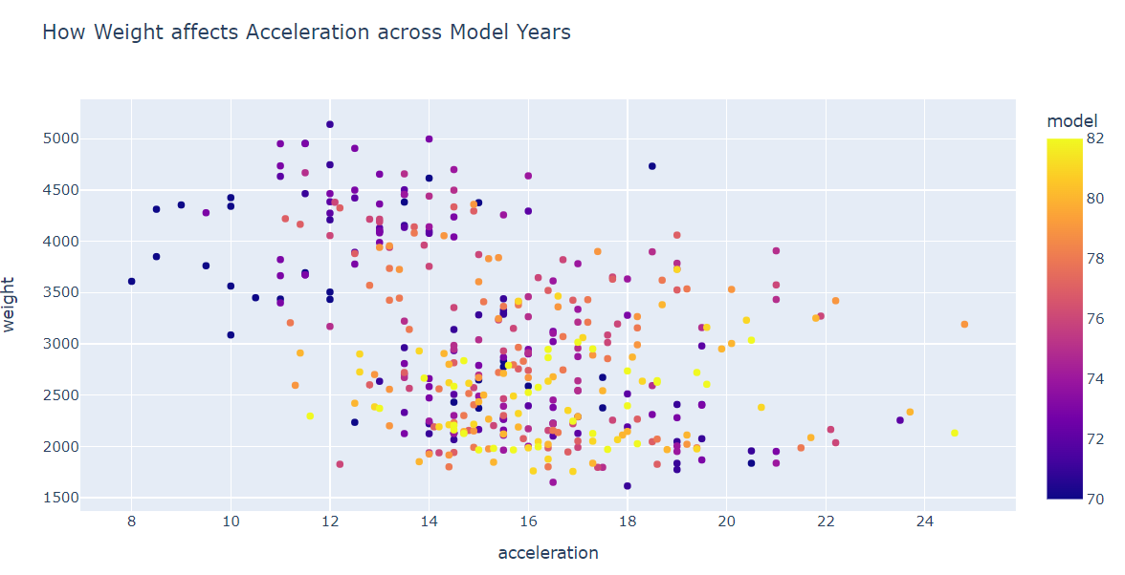
Weight v. Acceleration

Slide 11
Learning Models
Linear Regression:
The linear regression model that was used for this data set used a ratio of 70/30 for training and test data
The resultant from the test was an average MPG from the set of vehicles of 14.1.
This came closer to the average, with an accuracy of around 78%, which is a much healthier number by comparison to Random Forest.
Random Forest:
The random forest approach for the learning model with Python served to give a returned MPG value of 21.5.
This number returned higher than the average across all the years of the cars within the data set.
The accuracy of the model was around 68%

Slide 12
Data Interpretation

Slide 13
Recommendations
To make a good run of vintage cars, we should look into the years between 1978 to 1982.
The top performing cars across multiple categories were the Dodge Charger 2.2 from 1982 for MPG by weight, the 1980 Mazda GLC performing top of multiple categories, and the Volkswagen Rabbit, with multiple versions, also coming in as a pack leader across many years.
The general consensus is that the ideal weight and build for a vehicle comes in at around 2500-3500 lbs, giving an average MPG of around 25-32 per gallon, and an acceleration around 12-16.
The best performing 6 cylinder by 1982, was the Oldsmobile Cutlass Ciera, with an MPG of 38.
The expected values for MPG from Linear Regression was 14.1 with a 78.9% accuracy
The Random Forest Model was 21.5 per Gallon, with a 67.79% accuracy

Slide 14
Moving Forward
Gather a more intensive learning model that can predict an average MPG by weight and cylinders, alongside horsepower.
Some next steps would move into comparing models from around 1983 to 1990, to round out the selection of vehicles that the vintage remodeling company could pull from.

